Slide 1


Welcome to the Student Learning Outcome Process
Mary Pape
SLO/SSLO/AUO Coordinator
Visit us at deanza.edu/slo

Slide 2
Welcome
Name | Position
Alex Chang | Instructor - Chemistry Program
Andy Ponce de Leon | Instructor - PE Courses
Gayatri Pal | Instructor - Environmental Studies
Jakob Kotas | Instructor, Math (MPS) - Mathematics
Joshua McCluskey | Instructor - Environmental Studies
Kara Krone | Instructor - Design and Manufacturing Tech (DMT
Karina Cho | Instructor - Mathematics
Keri Kirkpatrick | Librarian - Library Services
Lara Ghisleni | Instructor - Anthropology
Marcel Macedo de Castro Lima | Instructor - General Music Courses
Marx Gomez Liendo | Instructor - Sociology
Nathaniel Tan | Instructor, Communications Studies - Intercultural Studies
Puya Ahmadieh-Yazdi | Counselor, Psychological Services
Sarah Wilker | Faculty Coordinator, Equity Office - Diversity & Equity
Tony Chang | Instructor, Business - Business General Courses

Slide 3
Outcomes for Today
Attendees will know where SLOs and their assessments can be found.
Attendees will be able to complete assessment summary.
Attendee will be able to form a student learning outcome statement.

Slide 4
Why Student Learning Outcome Process?
Culture of inquiry
Stakeholders demand assessment
Accreditation by ACCJC (Accrediting Commission for Community & Junior Colleges)
Notes:
Should note that for the SLO process, faculty are in charge. Faculty decide how it will be assessed and what the target or bench mark should be.

Slide 5
Contents
Planning cycle document
Our Road to “Proficiency”
“You” and this process

Slide 6
I. Developing Our Institution’s Planning Cycle

Slide 7
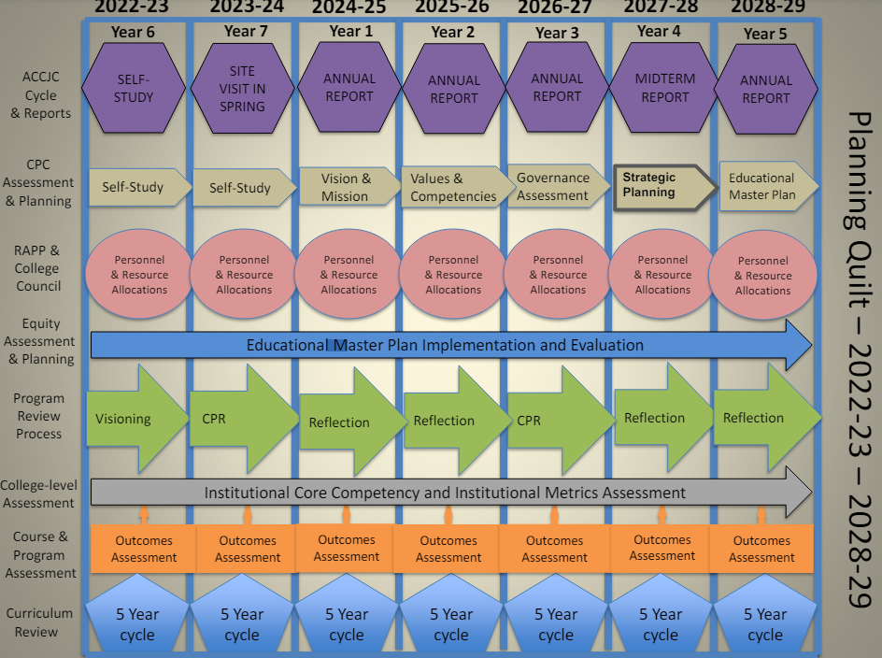
The Quilt https://www.deanza.edu/gov/planning/documents/Quilt_Chart_2023-28V2.pdf

Slide 8
Outcome Defined
(Redefined)
Conduct assessments
Summarizing data
Reflection
Enhancement
Plan methods of assessment

Slide 9
II. Our Road to “Proficiency”
A bit of Nostalgia

Slide 10
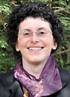
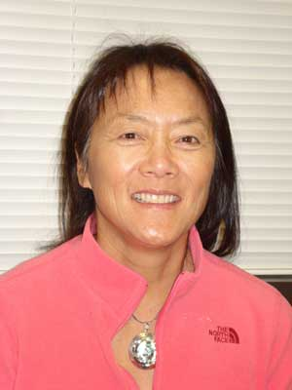
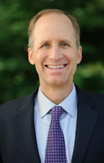
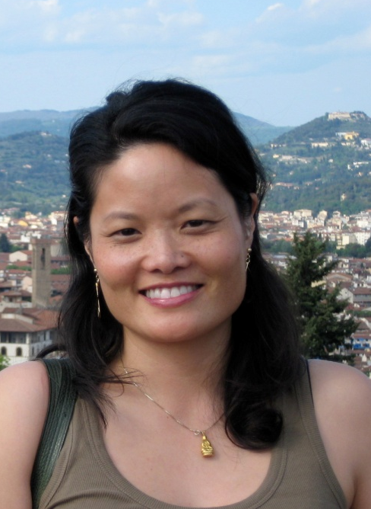
Academic Senate
Support from Presidents and Vice Presidents of Academic Senate: L->R: Anne Argyriou, Gregory Smith, Coleen Lee-Wheat, Karen Chou

Slide 11
SLO Steering Committee
Administrators & Faculty:
VP, Instruction
Associate VP, Instruction
Director, Institutional Research
Representative Academic Senate
Representative Curriculum Committee
SLO/SSLO/AUO Coordinators

Slide 12
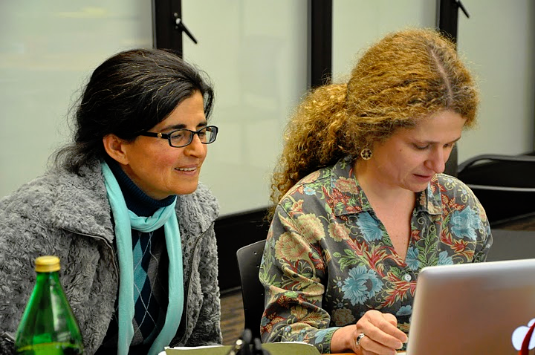
Leadership Structure
- Faculty Driven

Slide 13
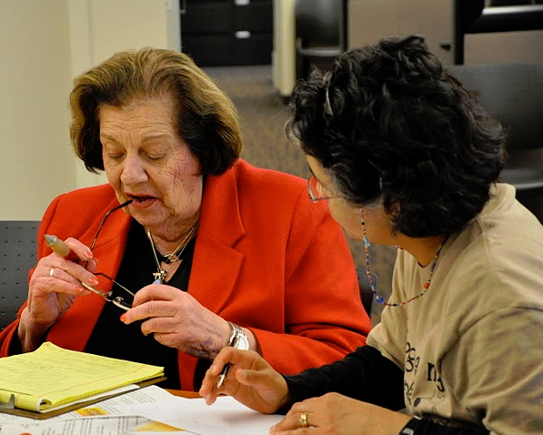
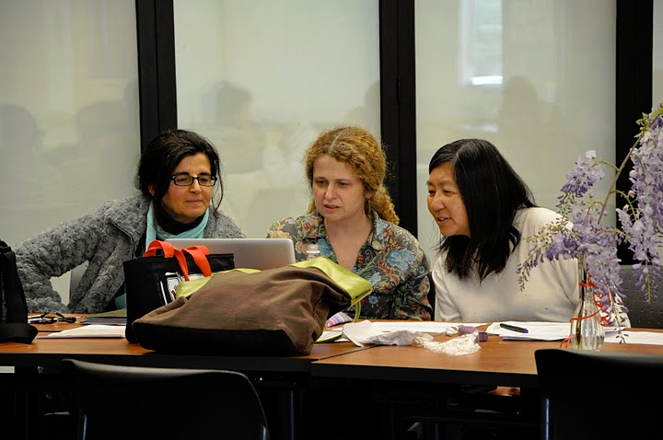
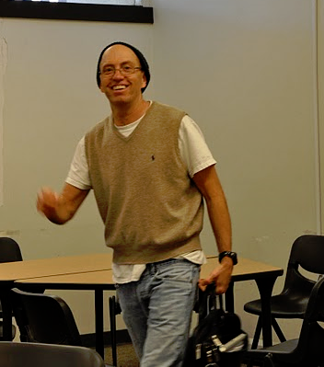
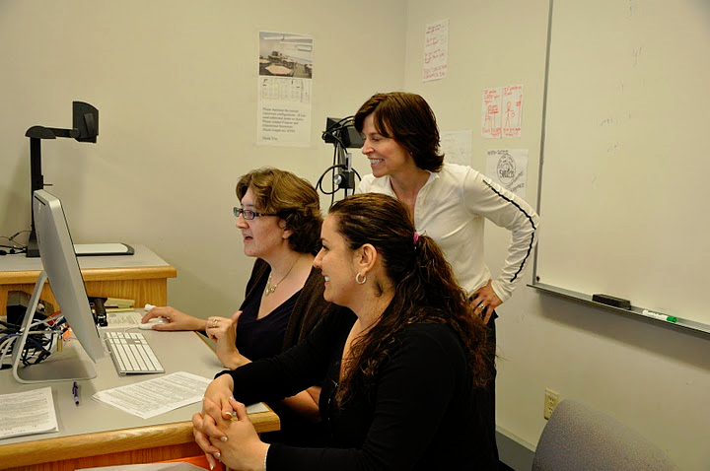

Slide 14
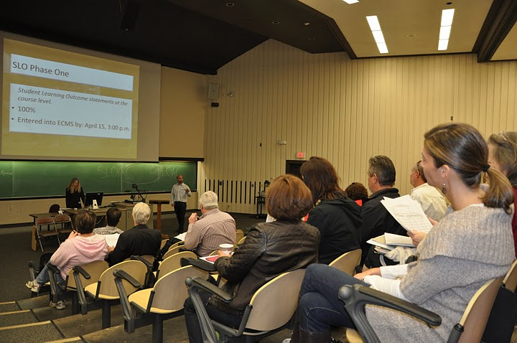
Dialog - Annual Convocation

Slide 15
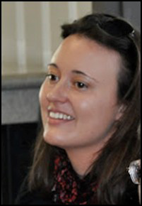

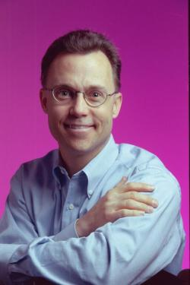
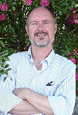
Division SLO Liaisons
Language Arts
Physical Science/
Math/
Engineering
Business/
Computer
Systems
Student Service:
Counselor

Slide 16
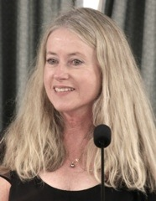
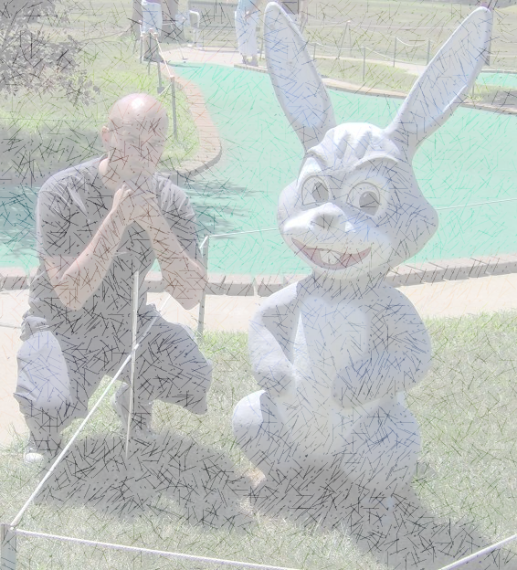
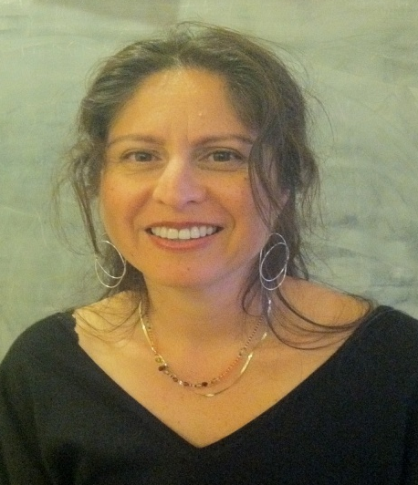
SLO Core Team
Student Services & Administrative Units Coordinator:
Veronica Acevedo Avila
Instructional Coordinator:
Mary Pape
Other SLO Core Team Members: **Mallory Newell ** Betty Inoue**Patty Guitron**

Slide 17
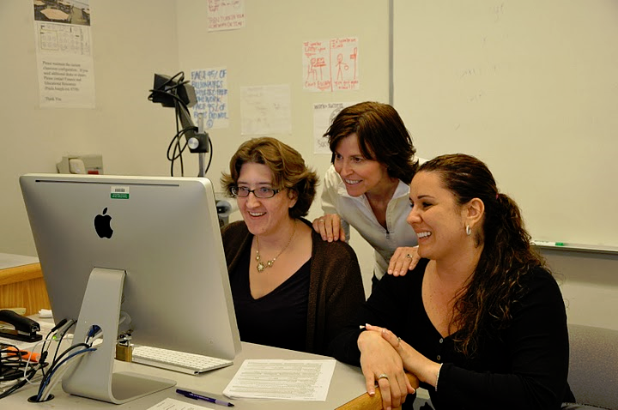
Dialog - Workshops

Slide 18
III. YOU in this process

Slide 19
Improving the Student Experience
Student Services Learning Outcomes
Administrative Unit Outcomes
Student Learning Outcomes
Course Level (CSLO)
Program Level (PSLO)
Institutional Level (ISLO)

Slide 20
Institutional
Level Outcomes & Assessments
Program Level Outcomes & Assessments
SLOACs/SSLOACs/AUOACs

Slide 21
Improving the Student Experience
Student Services Learning Outcomes are overarching, clear, and assessable statements that identify and define what a student will be able to know, do, or feel at the successful completion of a specific program, activity, or process.

Slide 22
Improving the Student Experience
Student Services Learning Outcomes
Upon completion of intake and orientation CalWORKs students will be able to demonstrate their ability to identify and access services available through the Financial Aid system.(Dept SS – Occupational Training Institute)

Slide 23
Improving the Student Experience
Administrative Unit Outcomes are overarching, clear, and assessable statements that identify and define what a client/customer/student will be able to know, do, or feel at the successful completion of a specific activity or process.

Slide 24
Improving the Student Experience
Administrative Unit Outcomes
Our goal is to provide the necessary information for clubs to carry out proper cash handling and submit supporting documentation to account for all money received documenting an audit trail.(Dept FER – FIN – Student Accounts)

Slide 25
Improving the Student Experience
Student Learning Outcomes
Course Level
Attainment of skills and competencies at the end of the course.

Slide 26
Improving the Student Experience
Student Learning Outcomes
Course Level
Understand and create a customized GPT. (CIS 67 Introduction to Prompt Engineering)

Slide 27
Improving the Student Experience
Student Learning Outcomes
Program Level
What the student will be able to do after completing a certain certificate/degree.

Slide 28
Improving the Student Experience
Student Learning Outcomes
Program Level
Design and utilize effective prompts for Large Language Models, which includes understanding and usage of … customized GPT (CIS: Applied Artificial Intelligence Certificate of Achievement)

Slide 29
Improving the Student Experience
Student Learning Outcomes
Institutional Level
(Institutional Core Competencies)
Communication and expression
Information literacy
Physical/mental wellness and personal responsibility
Civic capacity for global, cultural, social and environmental justice
Critical thinking
Quantitative Reasoning

Slide 30
Mapping
Critical
thinking
Communication and expression
Design and utilize effective prompts for Large Language Models, which includes understanding and usage of … customized GPT
Understand and create a customized GPT.

Slide 31
Your Assignment
Must use the Student Learning Outcome verbatim from the Course Outline of Record
Enter Assessment directly into Microsoft form: SLO Course Assessment

Slide 32
Your Assignment
Select your Division *
Enter the name of your department *
Enter the name of the course with section. For example, MATH 22-50Z *
Enter CRN# for course *
Enter SLO Statement(s) As it (they) appear on the Course Outline of Record. You may assess one or more at a time. *
Academic Year *
Quarter of Assessment *
Modality of class *
Method of Assessment *
Elaborate on Assessment Method *

Slide 33
Your Assignment
Assessment Data Summary
Approximate the number of students in the class that exceeded expectation, met expectations, approaches expectations, do not meet expectations, and N/A not applicable (such as withdrew from course or did not participate in assessment for any reason)

Slide 34
Your Assignment
11. Number of students exceeding expectations
12. Number of students meeting expectations
13. Number of students approaching expectations
14. Number of students who do not meet this/these outcome(s)
15. N/A Not Applicable (withdrew, absent, ...)
16. Reflection *
17. Enhancement/Action *

Slide 35
Your Assignment
Must use the Student Learning Outcome on the Course Outline of Record (see SLOs for Curriculum Committee)
Enter Assessment directly into Microsoft form: SLO Course Assessment

Slide 36
IV. Presents for you
Canvas does the work
Join Us -----→

Slide 37


Overview of Insights for Canvas Outcomes
Questions?
Maybe Interested?
Would like to know more about this entry of assessments while grading?
Would you like to be invited to a special “Early Adaptor” Workshop?
RSVP & Questions

