Slide 1

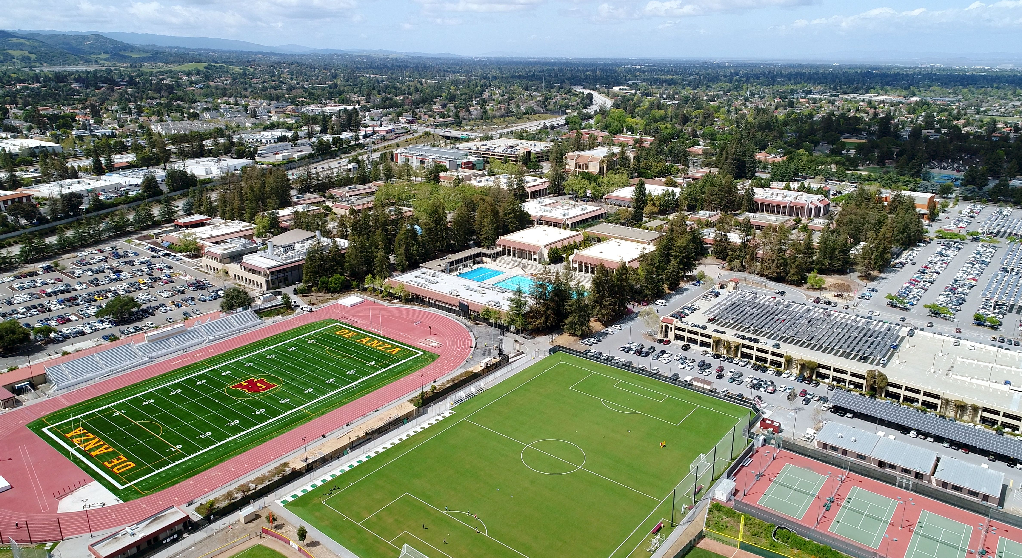
Governor’s January budget 2025-2026
College Council January 30, 2025

Slide 2
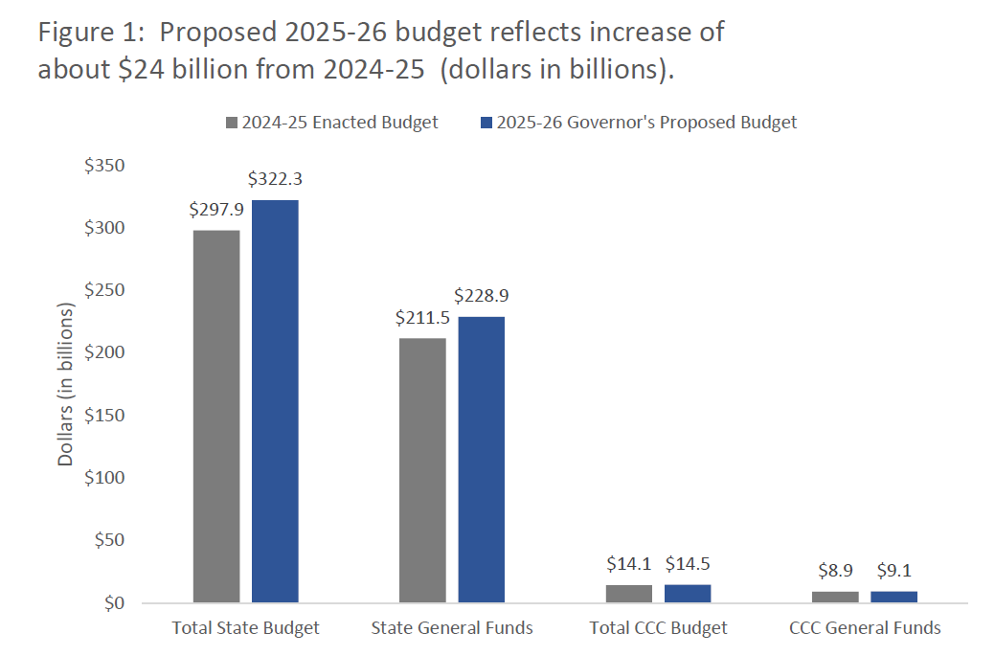
Governor’s January budget 2025-2026

Slide 3
Governor’s January budget 2025-2026
The budget proposal for the California Community Colleges reflects a significant focus on the Master Plan for Career Education and includes a vision of a Career Passport that would follow a student's educational journey.
The proposal for additional ongoing spending includes $230.4 million for a 2.43% cost-of-living adjustment (COLA) for community college apportionments, $28.7 million for COLAs and adjustments to certain categorical programs, and $30.4 million for systemwide enrollment growth of 0.5%.
One-time $133.5 million and ongoing $29 million funding in the proposal is dedicated to the establishment of a Systemwide Common Data Platform that would integrate a suite of technology tools, including e-Transcripts, the Mapping Articulated Pathways platform, and Program Pathways Mapper.
The proposal also includes $168 million one time to complete the Statewide Technology Transformation, which would standardize and streamline data collection to support more seamless educational and career transfers.
One-time $93 million and ongoing $7 million funding in the proposal is dedicated to scaling up Credit for Prior Learning policies.
The Governor's proposal includes capital outlay funds from Proposition 51 and Proposition 2 to support 31 projects, including De Anza’s Physical Education Complex Renovation.

Slide 4
Governor’s January budget 2025-2026

Slide 5
Proposed 2025-2026 SCFF Rates
*Ten districts receive higher credit FTES rates, as specified in statute.

Slide 6
student centered funding formula basics
California community colleges are funded annually by 3 separate allocations:
70% Base allocation (FTES + campus & center allocation)
  Credit FTES (three-year average; 70%)
  Special Admit, Incarcerated, and CDCP Noncredit (no three-year average; 100%)
  Non-enhanced Noncredit

Slide 7
student centered funding formula basics
California community colleges are funded annually by 3 separate allocations:
20% Supplemental allocation (low-income student population)
Allocated to each district based on total points calculated annually
  1 point for each student who receives financial aid (Pell)
  1 point for each student who is granted an exemption for non-resident tuition (AB 540)
    Non-resident student who attended a CA high school for at least 3 years & earned diploma
  1 point for each student who receives a California College Promise/formerly Board Of Governors (BOG) fee waiver

Slide 8
student centered funding formula basics
California community colleges are funded annually by 3 separate allocations:
10% Student success allocation (completion metrics)
Success Metrics averaged over three years
Only highest degree/award counted
Transfer based on UC/CSU criteria and only awarded to one District with 12+ units in prior year
  ADT
  AA/AS
  Baccalaureate
  Credit Certificates (16+ units)
  Completion of Math and English (year 1)
  Transfer to 4-year university
  Completion of 9+ CTE units
  Attainment of Regional Living Wage

Slide 9


