Slide 1
Courtship and marriage
SABDI ATRISTAIN, ELLA SHIH, KENDALL HEARNEY, JESSICA THAN

Slide 2
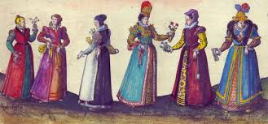
Courtship and Marriage in the Elizabethan Era for Women
Fathers had a large amount of control over who their daughters married
Single women were considered property of their father
Married women were considered property of their husband
Women were expected to run the household and have a lot of children due to the high mortality rate of children
Women who didn’t marry were suspected of being witches
1563: An Act Against Conjurations, Enchantments and Witchcrafts

Slide 3
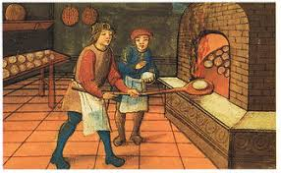
Courtship and Marriage in the Elizabethan Era for Men
Men were expected to support the household
Many waited to marry until they finished their apprenticeship and were financially stable
Unless they were a noble, men had to marry to become the legal head of a household
This enabled them to hold public office and other civic positions
Husbands were their wives legal guardians
Men were allowed punish their wives, especially when they suspected infidelity

Slide 4
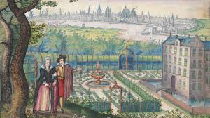
Courtship rituals
Men and women gave each other gifts such as gloves, lace, and rings
Courtship did not automatically lead to marriage
It was easy to break off a courtship, but marriages were difficult to dissolve.
If a courtship ended, all gifts were returned to the giver

Slide 5
Marriage Ceremonies in Elizabethan Era
People typically married in their twenties
Marriage contract
Dowry: the money, goods, or estate that a woman brings to her husband in marriage
Jointure: an estate or property settled on a woman at marriage, to be owned by her in the event of her husband’s death
Brides wore their finest dress and flowers in their hair
Wedding dresses were not necessarily white
Brides wore their hair down to symbolize purity
The groom was also expected to wear his best clothes
In The Taming of the Shrew, Petruchio does not look presentable and Katherine is upset as he is not following expectations of the time

Slide 6
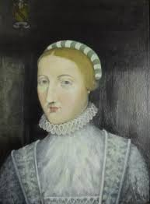
Shakespeare’s marriage
Shakespeare was 18 when he married Anne Hathaway in 1582
Anne was 26, which was a typical age to get married
Anne was already pregnant when they married
Shakespeare had to ask Anne’s father for permission to marry her
18 was considered a minor and they were unable to marry without permission
Since he married early, Shakespeare couldn’t complete an apprenticeship

Slide 7
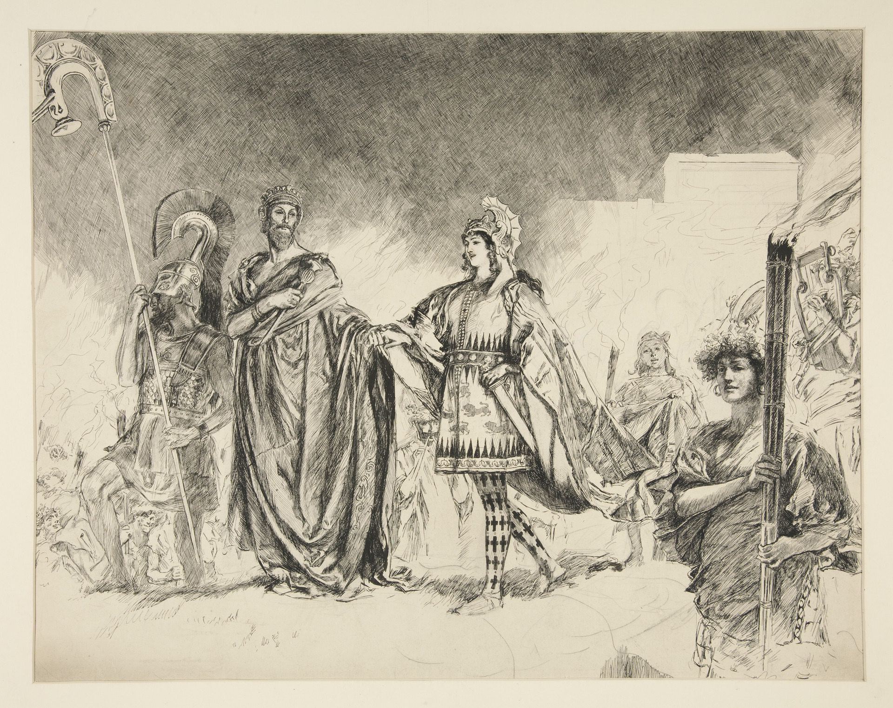
Courtship and Marriage shown in A Midsummer Night’s Dream
“I woo you with my sword/ and won thy love doing thee injuries, but I will wed thee in another key,/ with pomp, with triumph, and with reveling.” 1.1.17-20
”Three and three,/ We’ll hold a feast in great solemnity.” 4.1
source:https://www.pinterest.com/pin/470766967270525172/
Theseus wooing Hippolyta by showing that he is a powerful man, though war. Since he is an aristocrat, he also shows his capability in holding a huge feast.
Theseus says to hold a feast celebrating the marriage of the three couples. Probably because being an aristocrat, so he is going to do a ‘solemn’ feast.

Slide 8
Courtship and Marriage shown in A Midsummer Night’s Dream
”Come now, what masques, what dances shall we have.” 5.1.34-35
“Demetrius./ My noble lord, this man hath my consent to marry her.” 1.1.25-26
“Oh, hell, choose to love by another’s eyes!” 1.1.142
“And she is mine, and all my right of her I do estate unto Demetrius.” 1.1.99-100
From Theseus’ saying, we learn that dances and revelry are parts of the wedding celebration.
Hermia’s person to marriage is chosen by her father, Egeus.
Again as line 1.1.25-26 says Hermia can’t choose who to marry.
Wife becomes a possession of husband after marriage, said Egeus.

Slide 9
Courtship and Marriage shown in A Midsummer Night’s Dream
Said Helena. In contrast to Helena’s spontaneously total obedience to Demetrius, it seems it is conventional for man to woo woman.
The word blood here means hereditary rank. The love between Hermia and Lysander is not approved of by Egeus.
The only possible choice for lovers not approved is elopement.
”We should be wooed and were not made to woo.” 2.1.249
“The course of love never runs smooth-/ But either it was different in blood” 1.1.136-137
“ I have a widow aunt...There, gentle Hermia, may I marry thee;/ And to that place the sharp Athenian law/ Cannot pursue us.” 1.1.159-165

Slide 10
Courtship and Marriage shown in Much Ado About Nothing
In Claudio and Benedick’s appraisal about Hero, it seems woman can be bought as a commodity for marriage.
Benedick refuses to marry because he doesn’t believe women will keep their fidelity.
It seems that Leonato has the sole power to decide whether Hero can marry or not. She is not in charge of this at all. And it is unconventional that one man woos a woman for the other man.
“Would you buy her that you enquire after her?” 1.1.175-176
“In faith, hath not the world one man but he will wear his cap with suspicion?” 1.1.193-195
“Here, Claudio, I have wooed in thy name, and fair Hero is won. I have broke with her father and his goodwill obtained. Name the day of marriage” 2.1.292-295

Slide 11
Courtship and Marriage shown in Much Ado About Nothing
“She were an excellent wife for Benedick.” 2.1.343
“Well, niece, I trust you will be ruled by your father.”2.1.50-51
Said prince. He, Claudio, Hero, and their servants all tries to match the two together. It could be unconventional at that time since it is not father in charge of this courtship.
Leonato’s brother believes Hero will keep the duty of a woman that is to be obedient to her father probably in terms of marriage. He said this to her after hearing Beatrice’s view about marriage.

Slide 12
Courtship and Marriage shown in Much Ado About Nothing
“Dear my lord, if you in your own proof/ Have vanquished the resistance of her youth,/ And made defeat of her virginity.” 4.1.46-48
Magaret:“I saw the Duchess of Milan’s gown that they praise so. Hero: “Oh, that exceeds, they say.” Magaret:”By my troth, ’s but a nightgown in respect of yours—cloth o' gold, and cuts, and laced with silver, set with pearls, down sleeves, side sleeves, and skirts, round underborne with a bluish tinsel. But for a fine, quaint, graceful, and excellent fashion, yours is worth ten on ’t.” 3.4.15-23
Said Leonato. It seems woman has to keep her virginity before marriage. However, it seems that it is fine to consummate if the couple have regarded each other as husband and wife.
Woman wears very expensive and exquisite clothes for their marriage.

Slide 13
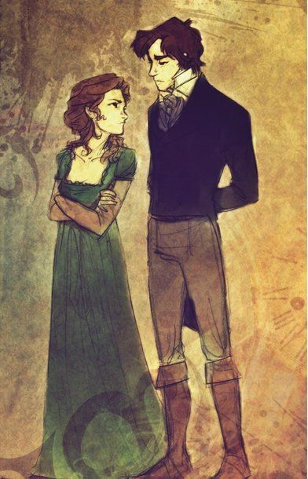
Courtship and Marriage shown in Much Ado About Nothing
“For here’s a paper written in his hand… fashioned to Beatrice.” “And here’s another,/ Writ in my cousin’s hand...Containing her affection unto Benedick.” 5.4.90-95
After the two paper shown, as a gift in courtship, Benedick and Beatrice consents their own marriage.
Source: https://www.pinterest.de/pin/355714070550868589/

Slide 14
Courtship and Marriage shown in The Taming of the Shrew
Women are made to bear, and so are you. (2.1. 200)
Alas, good Kate, I will not burden thee,
For knowing thee to be but young and light. (2.1. 202-203) Petruchio
Ay, when the special thing is well obtain’d,
That is, her love; for that is all in all. (2.1. 128-129) Baptista
She, poor soul,
Knows not which way to stand, to look, to speak,
And sits as one new risen from a dream. (4.1. 184-186) Curtis
Petruchio reminds Katherina of a woman’s role during their first encounter
Does Baptista really care about Katherina’s happiness and is that of utmost importance to him?
Womens’ loss of power in a marriage

Slide 15
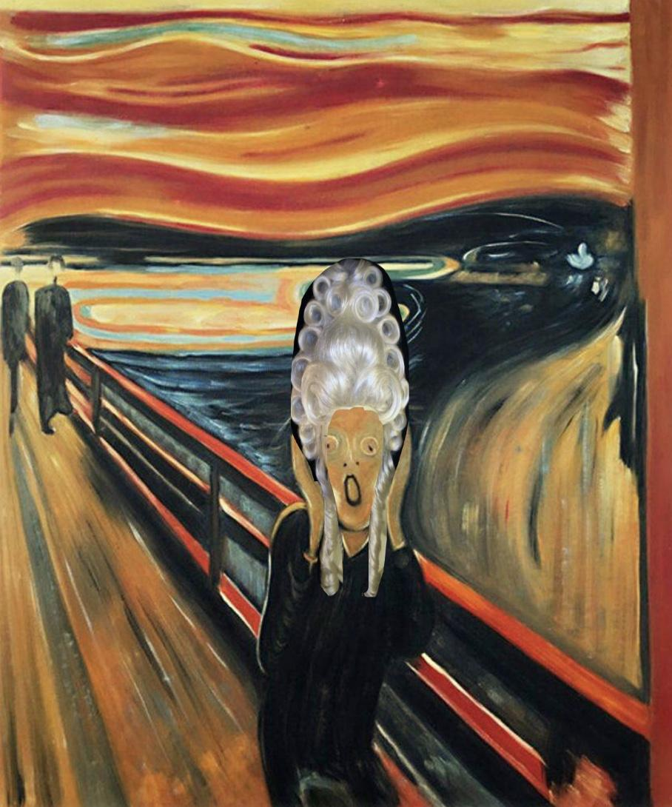
“ ” Cont’d
And pass my daughter a sufficient dower,
The match is made and all is done:
Your son shall have my daughter with consent. (4.4.45-47) Baptisa
Where then do you know best
We be affied and such assurance ta’en
As shall with either part’s agreement stand? (4.4. 48-50) Tranio as Lucentio
KATHERINA’S WHOLE SPEECH (5.2. 136-179)
Baptisa makes sure that Bianca will be put into great hands by someone wealthy and someone she cares for. The two properly finalize an engagement.
“Proper” ways of being a wife and her duties

Slide 16
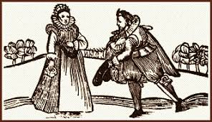
Reasons for Marriage
Spread of wealth between families, along with territories and prestige.
A means to ensure an heir for families
Cemented alliances between families
Because marriages were superficial in high society it wasn’t uncommon for nobility to live seperate from their wives

Slide 17
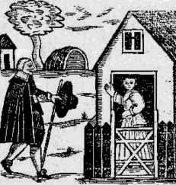
How were partners chosen ?
Parents mainly chose their children's partner
While children from higher standing had no say in their spouse, people from lower classes were sometimes allowed to have a say in the process
Some would leave for apprenticeships in an attempt to find love while away from family influence

Slide 18
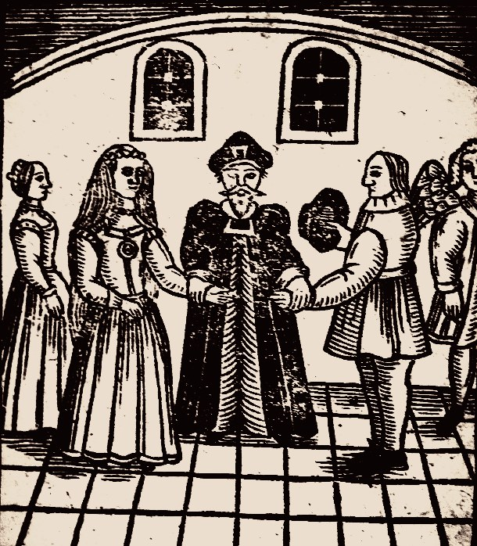
Age and Marriage
Up until 1650’s there were no actual laws when it came to an age of consent for marriage
It was common for girls as young as 12 and boys as young as 14 to be betrothed.
In 1653 the Marriage Act was set that made it that the youngest a girl could be to be wed was 14 and 16 for boys.
Despite the age limit being set so low it was common for people to wait until after apprenticeships ended before marrying in order to ensure there would be financial support for the new house.

Slide 19
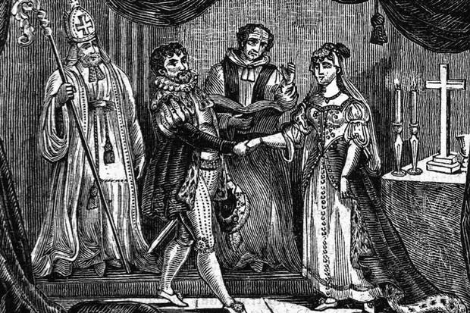
Marriage Process
Courting process could take as long as years, there was no set period of time
Once you were ready to wed you had to get the church’s approval by either
Buying a wedding license
Having your name along with your spouse's name be read during mass for 3 sundays in a row
Getting married could still take up to another month of waiting after getting the churches approval

Slide 20
Review
What was the name of the play that Elizabeth went to see?

Slide 21
Review
Before the marriage act, what ages were considered acceptable for betrothals?

Slide 22
Review
What is the difference between a dowry and a jointure?

