Slide 1
Engineering & Manufacturing Career Pathways
Skills for a future strong workforce

Slide 2
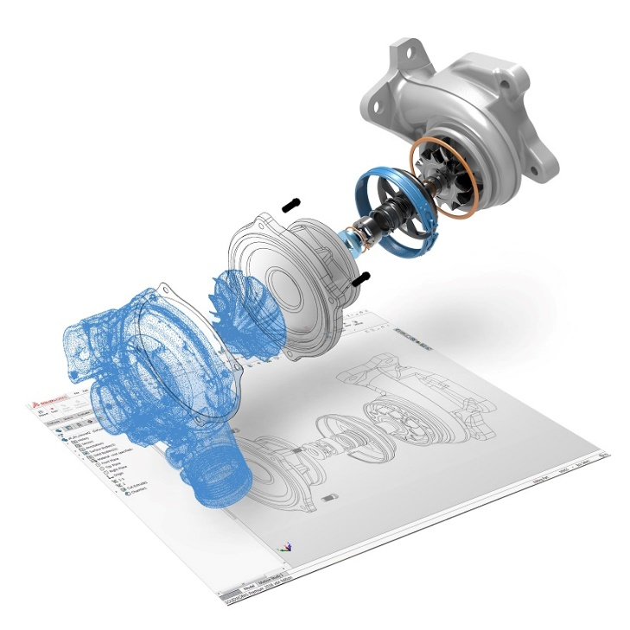
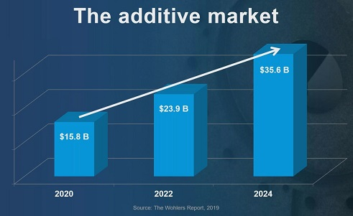
DMT - Skills for the future
Critical skills for Engineers, Industrial Designers and more
CAD - Parametric Mechanical Design tools
3D Printing / Additive Manufacturing “AM”
Traditional Manufacturing, CNC & CAM

Slide 3
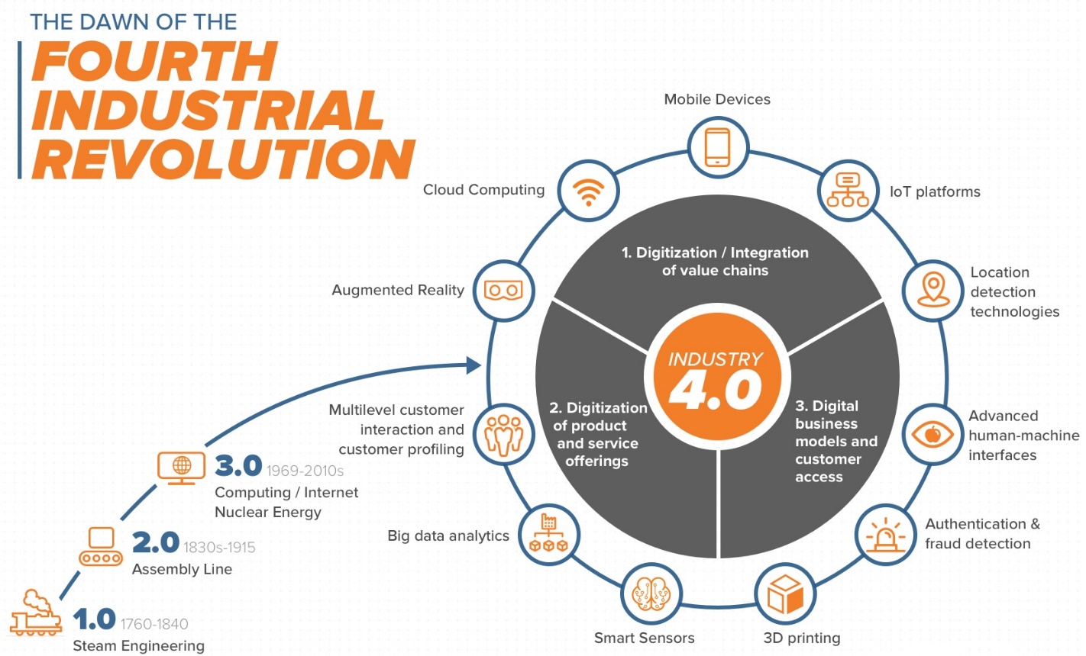
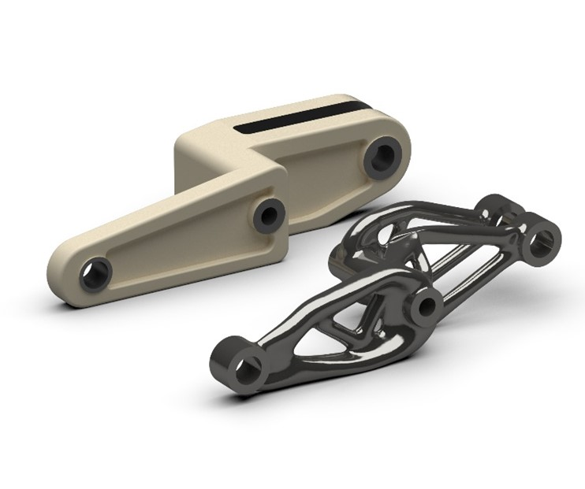
Charting a pathway to professional success in the 4th Industrial Revolution
AI-driven Generative Design

Slide 4

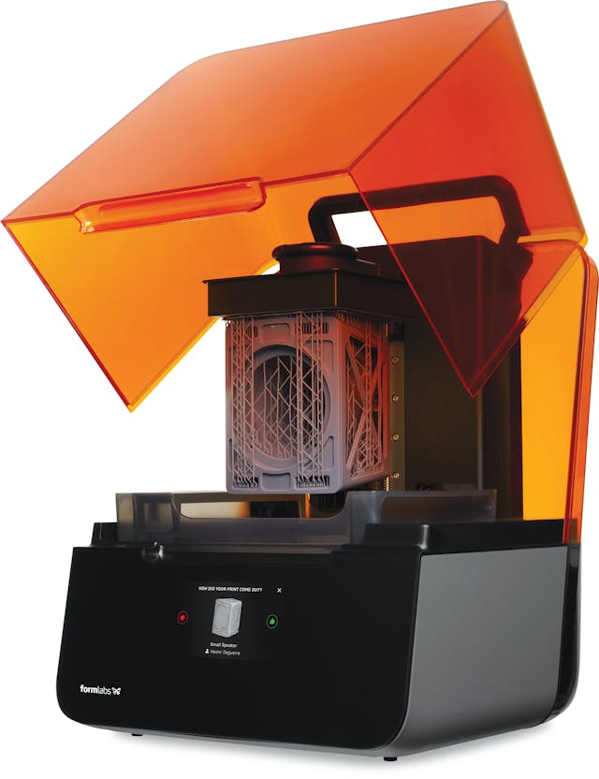
DMT Course Summaries
Dual Enrollment Program
DMT 55 Survey of Design & Manufacturing Processes
DMT 53 Intro to Additive Manufacturing
DMT 54 Product Development with 3D Printing
DMT 56 3D Printing Technician
DMT 57 Design for Additive Manufacturing
Additive Manufacturing Technician Certificate

Slide 5
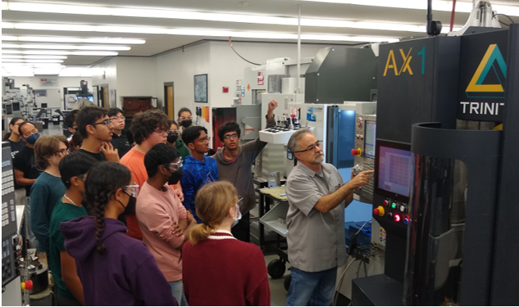
DMT 55: Survey of Design & Manufacturing Processes
DMT 55
Survey of Computer Aided Design (CAD), Machining, and 3D Printing
Build insight into how products are designed and fabricated
Explore modern manufacturing processes & equipment
Gain skills in CNC machine setup, blueprint reading, measurement tools, and rapid prototyping
Work on team-based, real-world projects

Slide 6
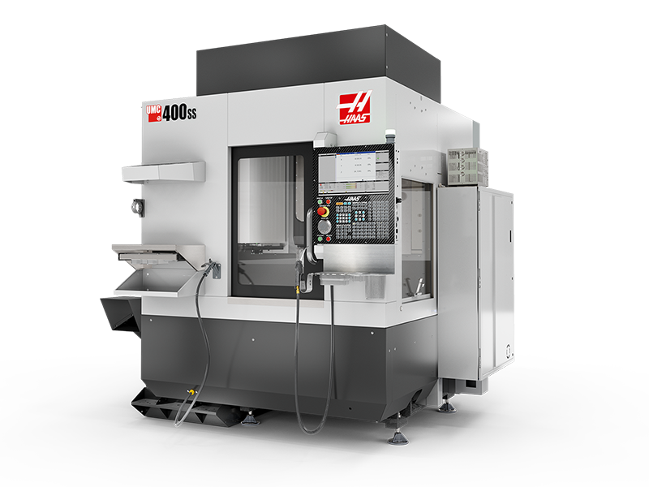
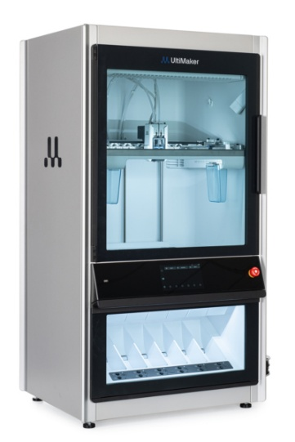
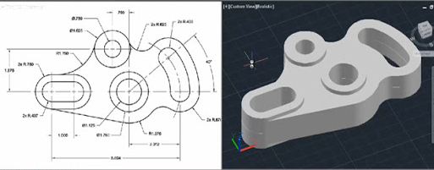
DMT 55: Survey of Design & Manufacturing Processes
What you’ll learn
Four weeks: Computer Aided Design (CAD)
3D modeling in SolidWorks, blueprint reading, project workflows, and best practices.
Four weeks: CNC Machining & Measurement
Mill and lathe machining, CNC, and precision measurement tools.
4 weeks: 3D Printing
Two projects using industrial grade 3D printers, slicing software, Design for Additive Manufacturing (DfAM)

Slide 7
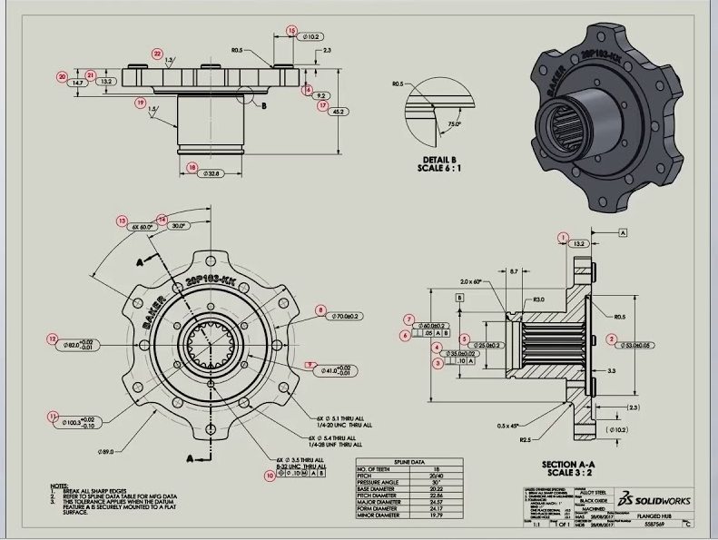
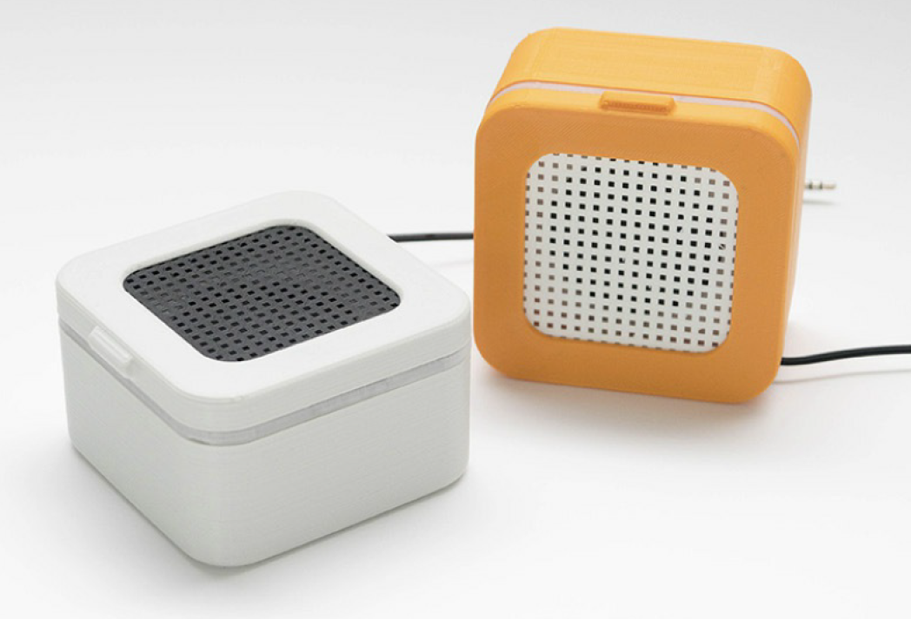
What is CAD?
CAD (Computer Aided Design): Software that designers and engineers use for product
development and design.
Helps designers, engineers, architects, and others create accurate 3D models and technical drawings.
Optimize designs – prototypes can be printed, tested, and easily modified in CAD.
Creativity & invention: Bring your own ideas to life
Speaker enclosure printed w/snap-fit joints
The 3D Printing Handbook, pg. 43

Slide 8


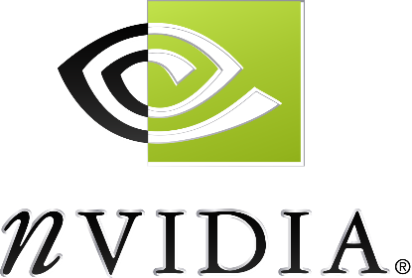
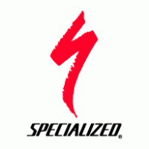





Local companies that use CAD to design products
CAD at De Anza College
Creo Parametric
Autodesk Inventor
SolidWorks
Siemens NX

Slide 9
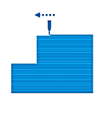
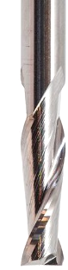

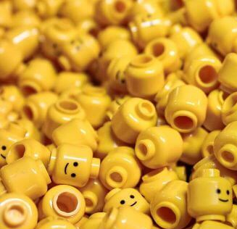
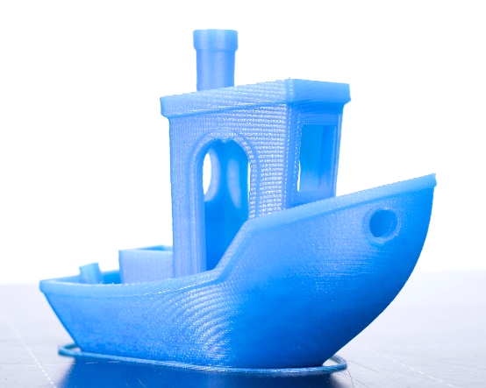
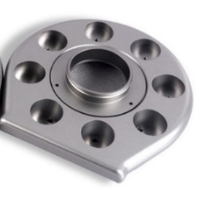
Types of Manufacturing
Additive
(e.g., 3D Printing)
Subtractive
(e.g., CNC Machining)
Formative
(e.g., Injection Molding)
Affordable at low volume (prototyping)
“Free Complexity”
Limitations in strength & precision
Post-processing required
Strong, precise parts
Limited complexity
High investment for tooling / setup
Material waste
Great for high volume production
Molding design & fabrication =
Even higher initial investment

Slide 10
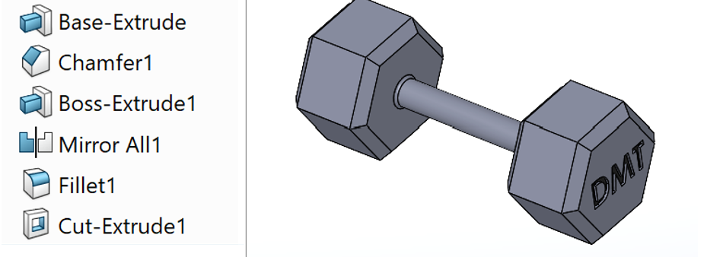
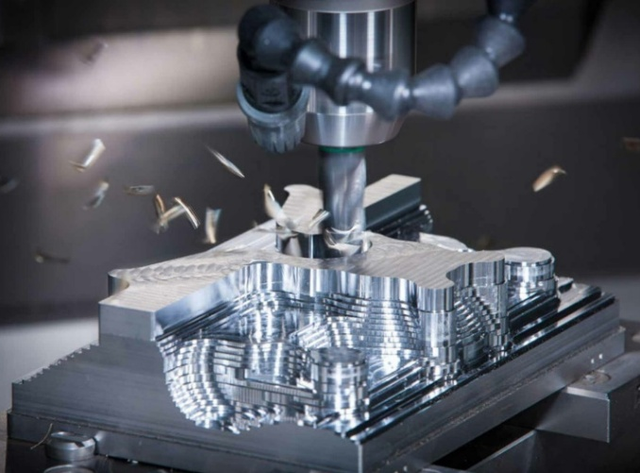
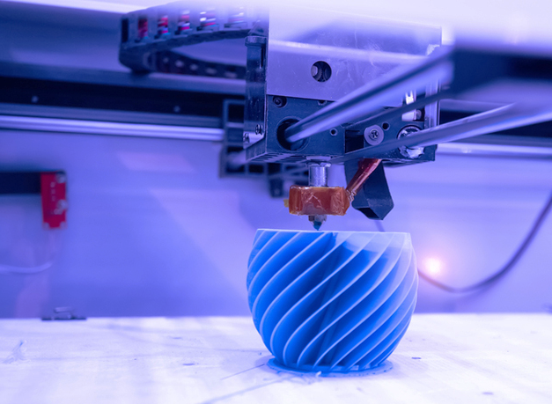
CAD (Computer Aided Design)
additive-vs-subtractive-manufacturing
www.3dnatives.com/en/mit-10x-faster-3d-printer
Machining
3D Printing
Subtractive Manufacturing
Additive Manufacturing

Slide 11
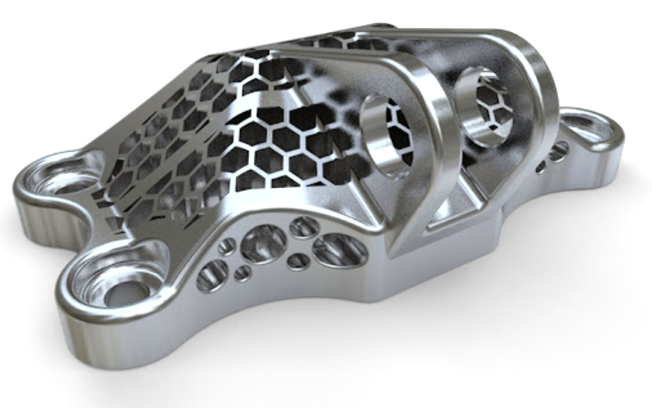
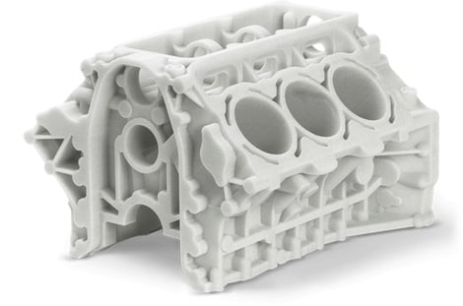
Manufacturing Process
Machining complex parts
Expensive, but strong and precise
3D printing complex parts
Affordable, but reduced strength and precision
Choose the right tool for the job!

Slide 12
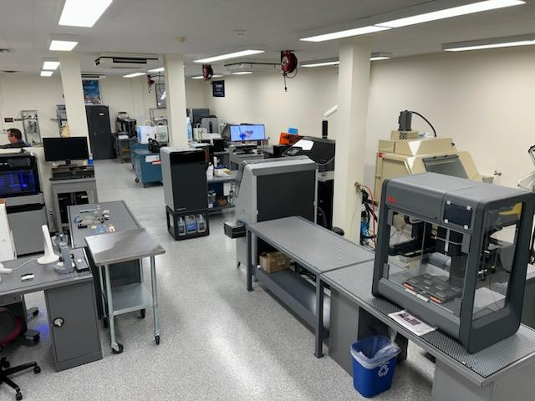
DMT 53: Intro to Additive Manufacturing
DMT 53
Understand how modern industries use 3D printing in engineering, medicine, product design, and manufacturing
Gain hands-on experience printing with industrial-grade machines
Setup, design, and assess 3D printed parts across major technologies
Discover the latest trends and future technologies in additive manufacturing

Slide 13
DMT Dept’ offers professional engineering pathway skills
3D Printing (“Additive Manufacturing”)
Additive Manufacturing is rewriting the rules for how we design, build, and create in every major industry.
From consumer product and industrial design, automotive, medical to Aerospace industries, the landscape is changing fast and we are here to train the future workforce.
www.deanza.edu/dmt/

Slide 14
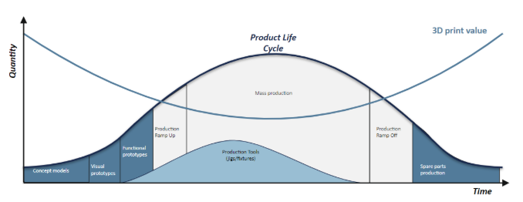
Product Life Cycle: Where does AM fit?
The most effective use of 3D printing technology is at the first and last stages of a product’s life cycle
Product Life Cycle
3D print value
Quantity
Mass Production
Production
Ramp Up
Production
Ramp Off
Functional
Prototypes
Production Tools
(jigs/fixtures)
Visual
Prototypes
Spare Parts
Production
Proof of Concept
Time
https://www.maker3d.fi/en/3d-printing-is-best-applied-to-novel-concepts/

Slide 15
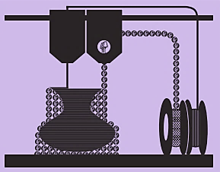
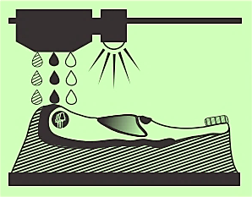
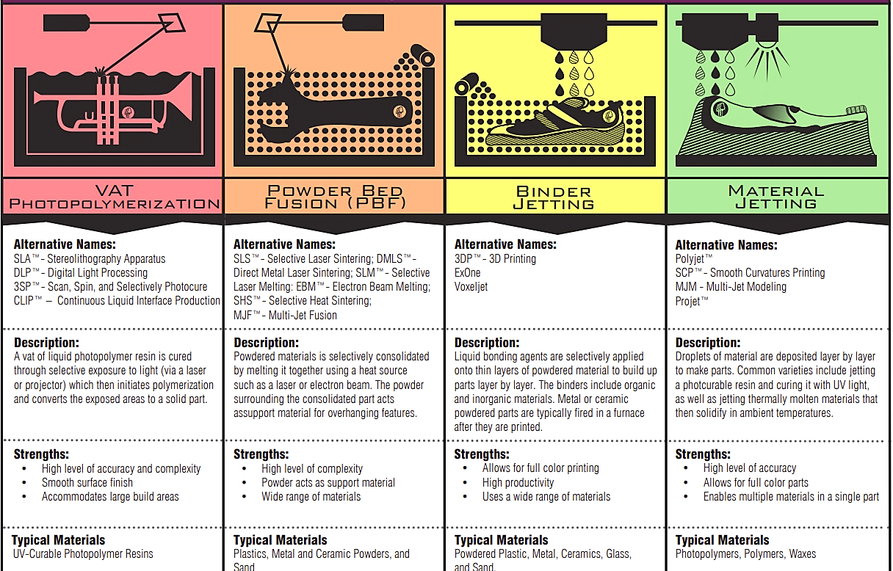

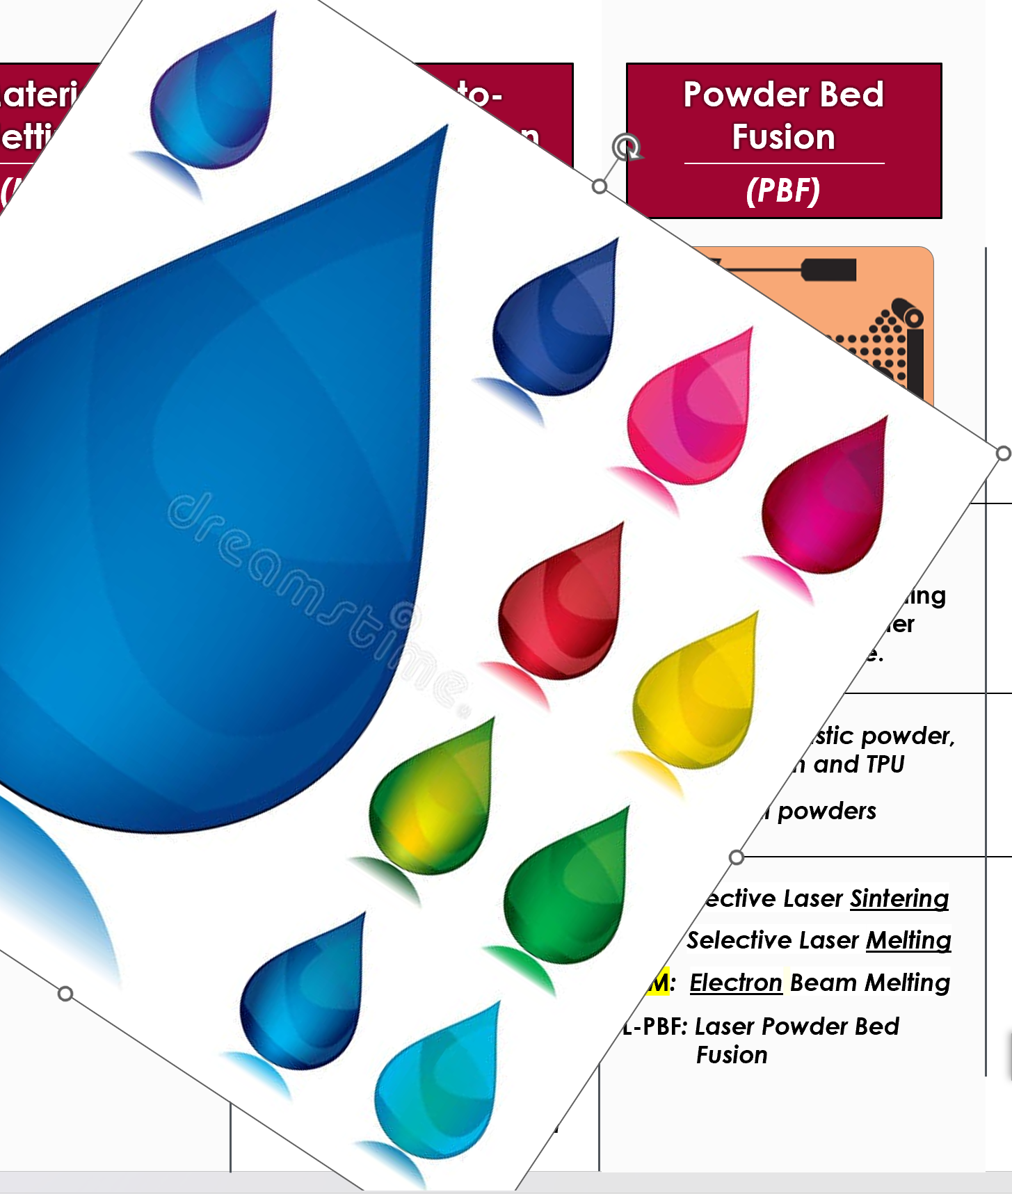
Process:
Abbreviation:
Material
Extrusion
(MEX)
Material
Jetting
(MJT)
Vat Photo-polymerization
(Vat Pho or VPP)
Powder Bed Fusion
(PBF)
Binder
Jetting
(BJT)
Description:
Material (usually melted thermoplastic) is extruded through a nozzle in tracks.
Droplets of photopolymer resin are deposited from nozzles and cured from above with UV light
A vat of photopolymer resin is cured through exposure to UV light,
A bed of powdered material is selectively fused via melting or sintering using a heat source such as a laser.
Liquid binder is applied to a powder bed.
Metal BJT is sintered in a furnace after printing.
Typical materials:
Thermoplastic filaments such as PLA, ABS, ASA; metal rods, cement, food, etc.
UV curable photopolymer resins and support material
UV curable photopolymer resins
SLS: Thermoplastic powder,
e.g. nylon and TPU
SLM : Metal powder
Plastic & metal powder, ceramics, glass, sand
Alternate Names:
FFF: Fused Filament
Fabrication
FDM: Fused Deposition
Modeling
Polyjet
SLA: Stereolithography
DLP: Digital Light
Processing
mSLA: (LCD) Masked
Stereolithography
CLIP: Continuous Light
Interface Production
SLS: Selective Laser Sintering
SLM: Selective Laser Melting
EBM: Electron Beam Melting
L-PBF: Laser Powder Bed
Fusion
BJT: Binder Jetting
MBJ: Metal Binder Jetting
MJF: Multi Jet Fusion

Slide 16
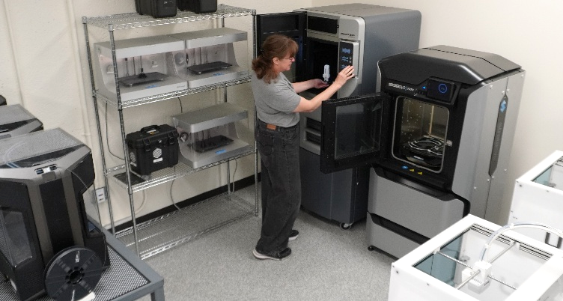
3D Printing Technologies @ De Anza
“Additive Manufacturing”
3D Printing Lab
Industry Technologies:
Fused Deposition Modeling (FDM)
HP Multi-Jet Fusion (MJF)
Selective Laser Sintering (SLS)
Bound Metal Deposition
Stereolithography (SLA)
Polyjet

Slide 17
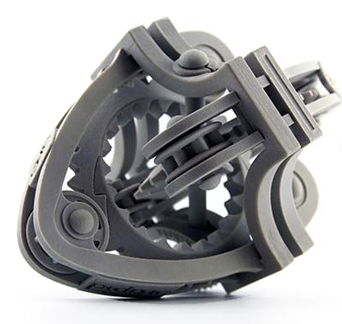
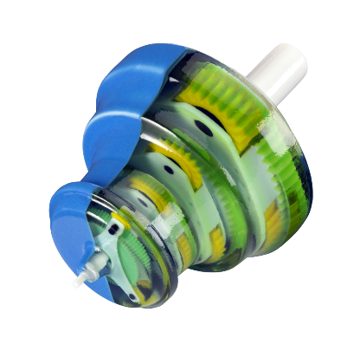
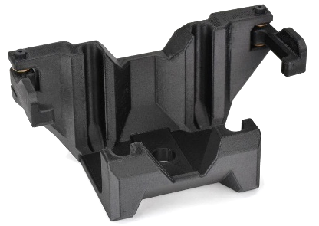
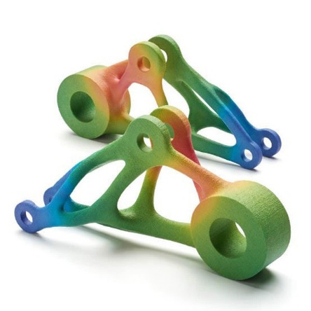
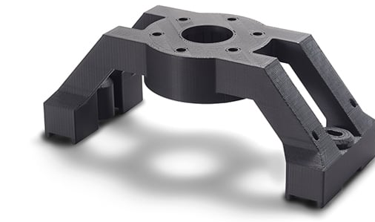
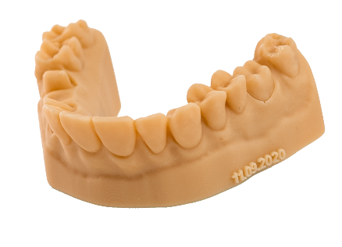
3D Printing Technologies @ De Anza
Powder Bed Fusion
~ Strength & design complexity
FDM / MEX:
Engineering Grade Thermoplastics
Photopolymer Resins
~ Detail & color
~ Medical
Diran 410

Slide 18

DMT Dept’ offers professional engineering pathway skills
Dual Enrollment Course HHS
Current high school student can enroll for College credits as a 7th period class
Sign up by contacting your guidance counselor
Email Derek Chan - derek_chan@fuhsd.org
Gain experience with college-level studies
Advance your career and future University prospects at De Anza College
Opportunity to explore potential majors and career paths
DMT 55 starts Sept. 22nd at De Anza College
DMT 53 starts Jan. 5th 2026
www.deanza.edu/dual/fuhsd/
Tiffany Rodriguez-Tran rodrigueztrantiffany@fhda.edu

Slide 19
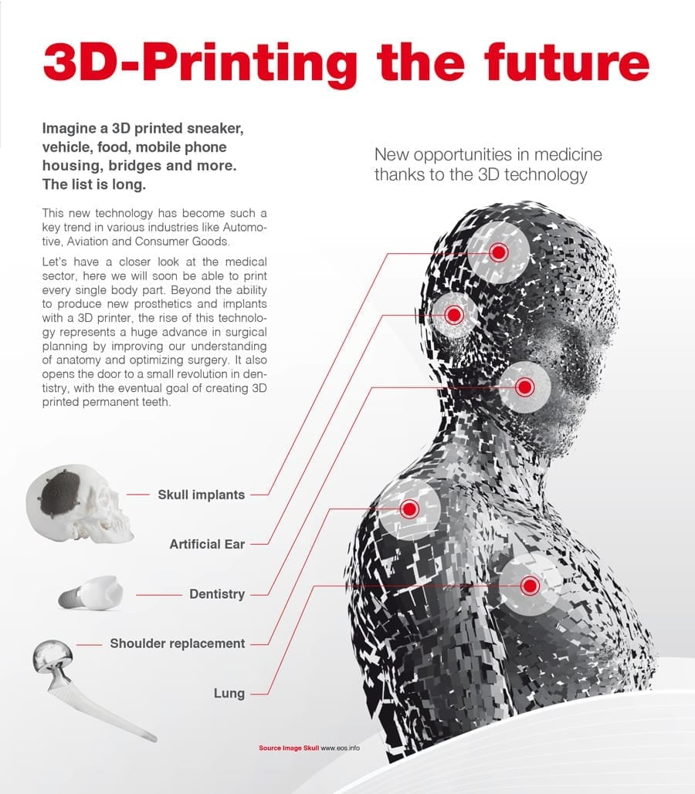
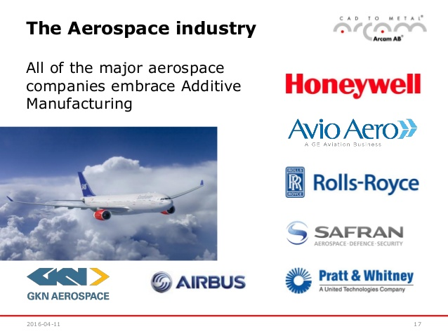
Nearly every industry uses CAD & most use 3D Printing
https://www.youtube.com/watch?v=7le2EoJ8b8Q https://youtu.be/A2d96-bCpvo
https://jobs.gecareers.com/global/en/ge-additive-careers https://www8.hp.com/us/en/printers/3d-printers.html

Slide 20
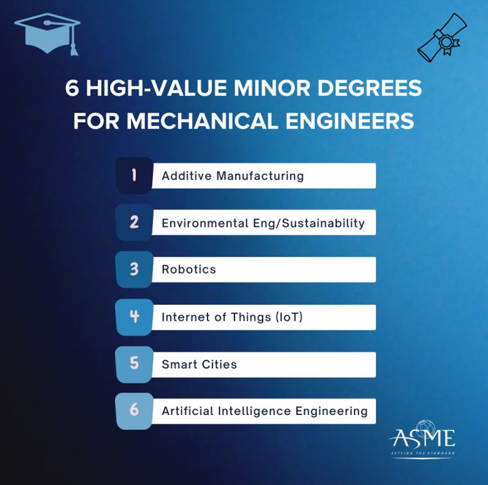
Nearly every industries uses CAD & Many use 3D Printing
https://www.youtube.com/watch?v=7le2EoJ8b8Q https://youtu.be/A2d96-bCpvo
https://jobs.gecareers.com/global/en/ge-additive-careers https://www8.hp.com/us/en/printers/3d-printers.html

Slide 21
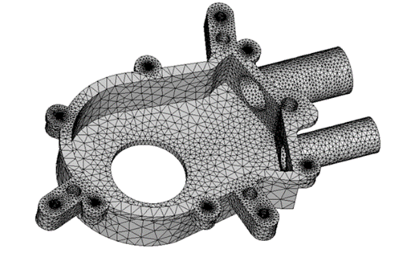
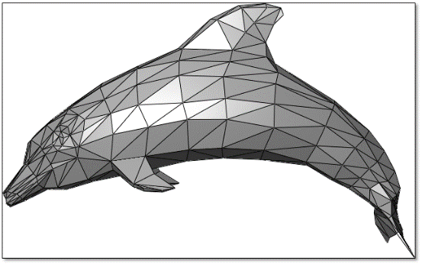
Universal aspects of all 3D printing
Parts are built Layer by Layer
3D Geometry is converted to 2D slices, then recompiled during printing
CAD to Print File
Software translates between your CAD geometry & 3D Printing process (slicing software)
STL "stereolithography“ file

Slide 22
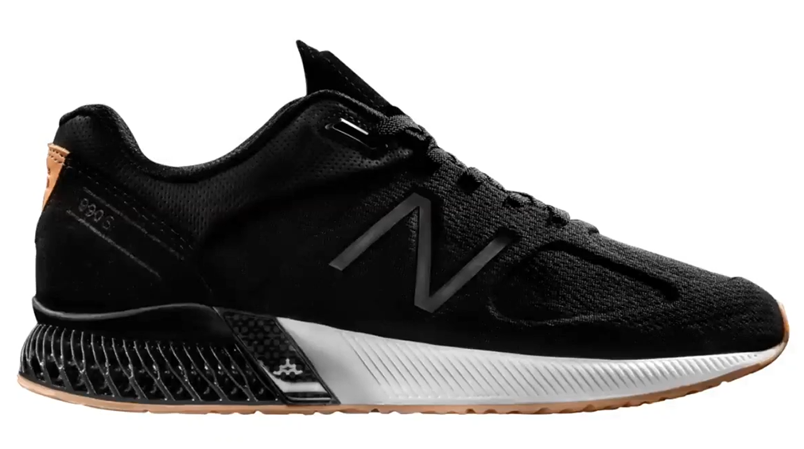
Basics of 3D Printing Technology
CAD to Print File, Typically STL or 3MF
Printing Process Mechanism (Pros & Cons)
FDM/FFF
SLS, MJF & DLMS
SLA & DLP
MJP - Material Jetting
Post Processing
Maintenance and Scalability

Slide 23
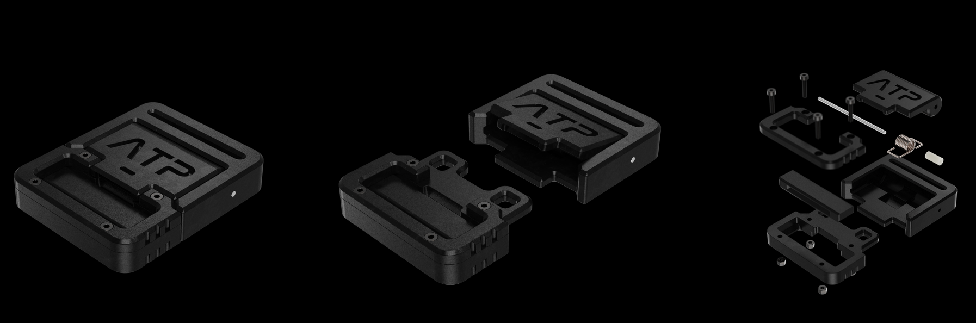
Resent Success story – A vision & passion for success
Dane Jones: https://www.daneerikjones.com/
Chemical Engineering student turned Designer, now works in AM Hardware industry

Slide 24
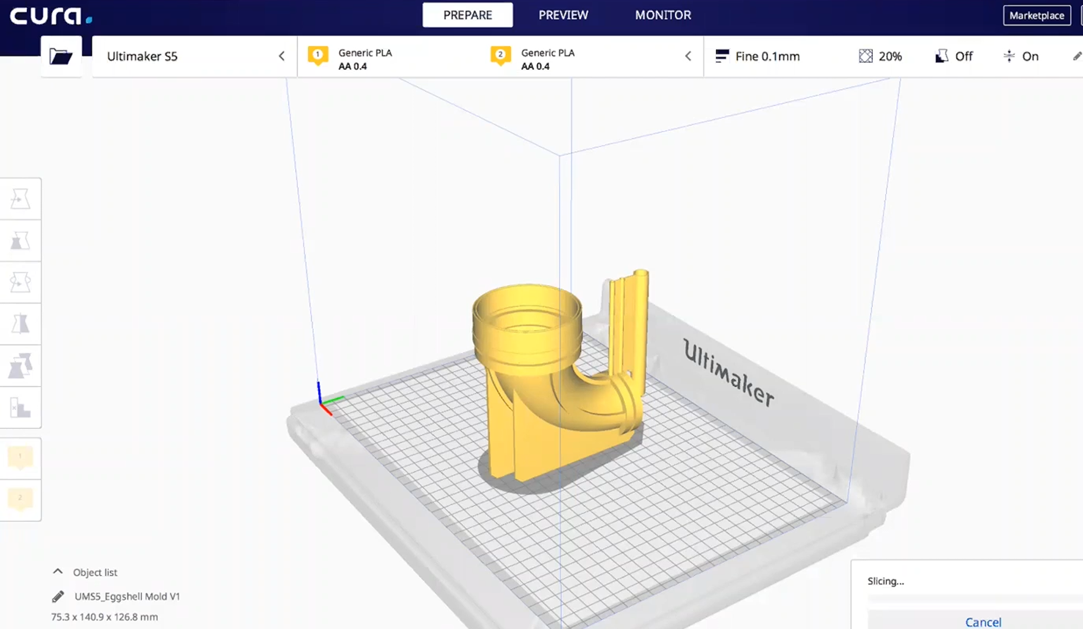
Slicing software

Slide 25
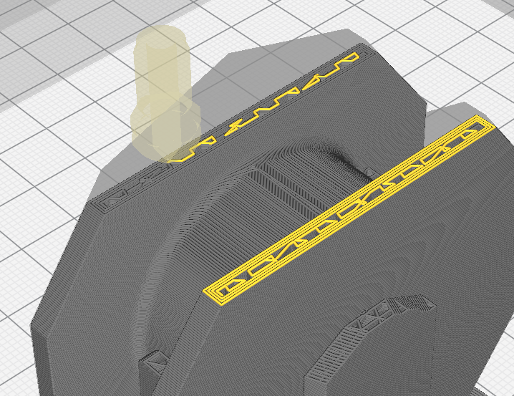
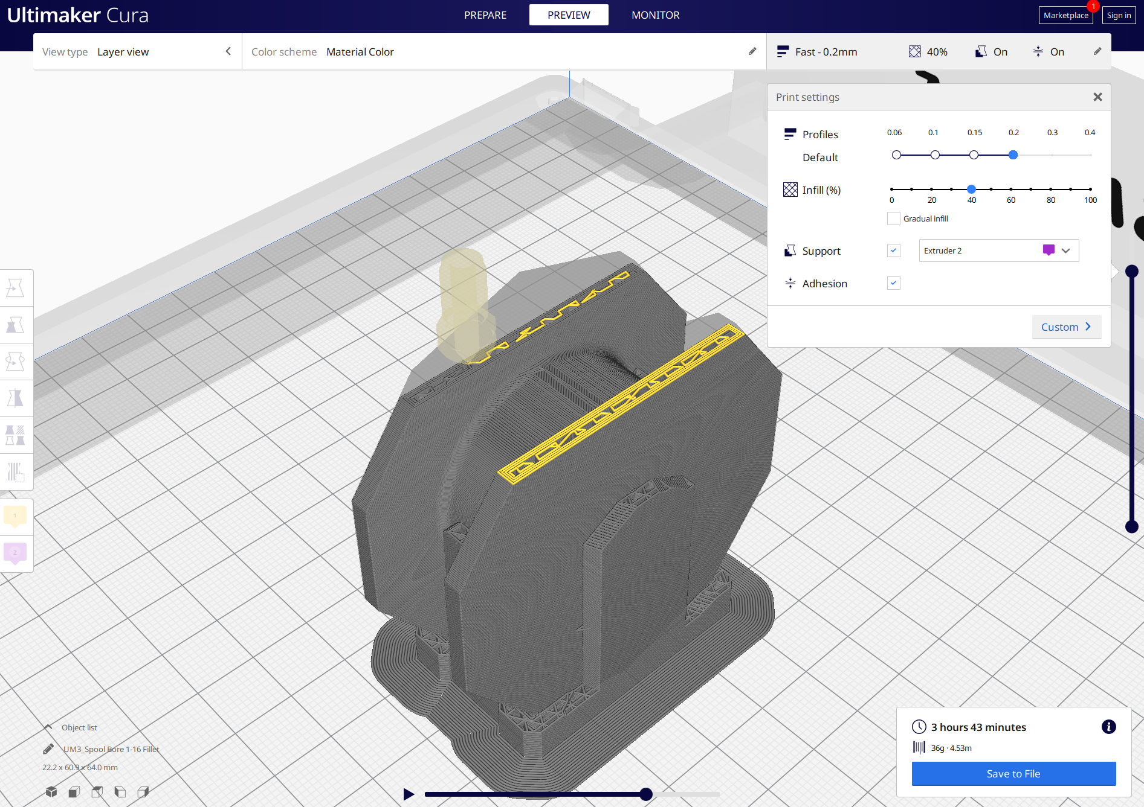
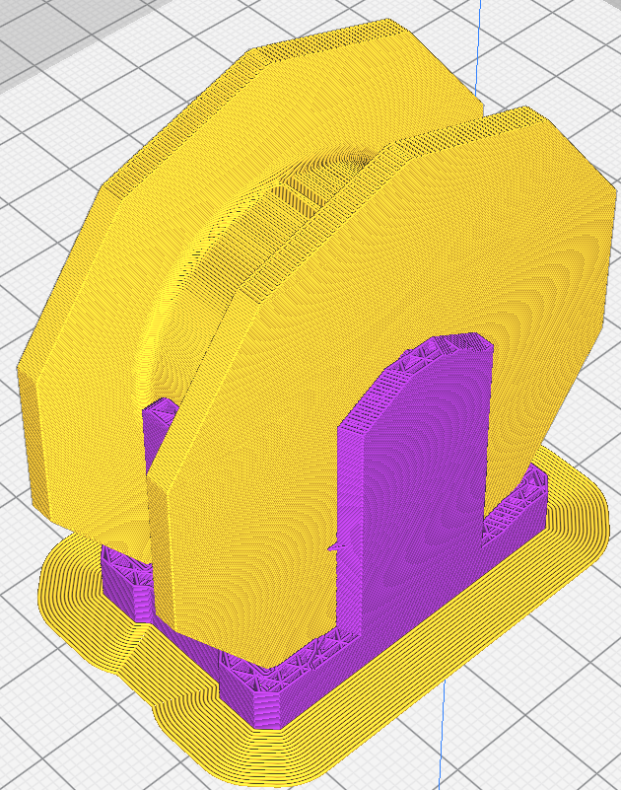
FDM slicing with support structure

Slide 26
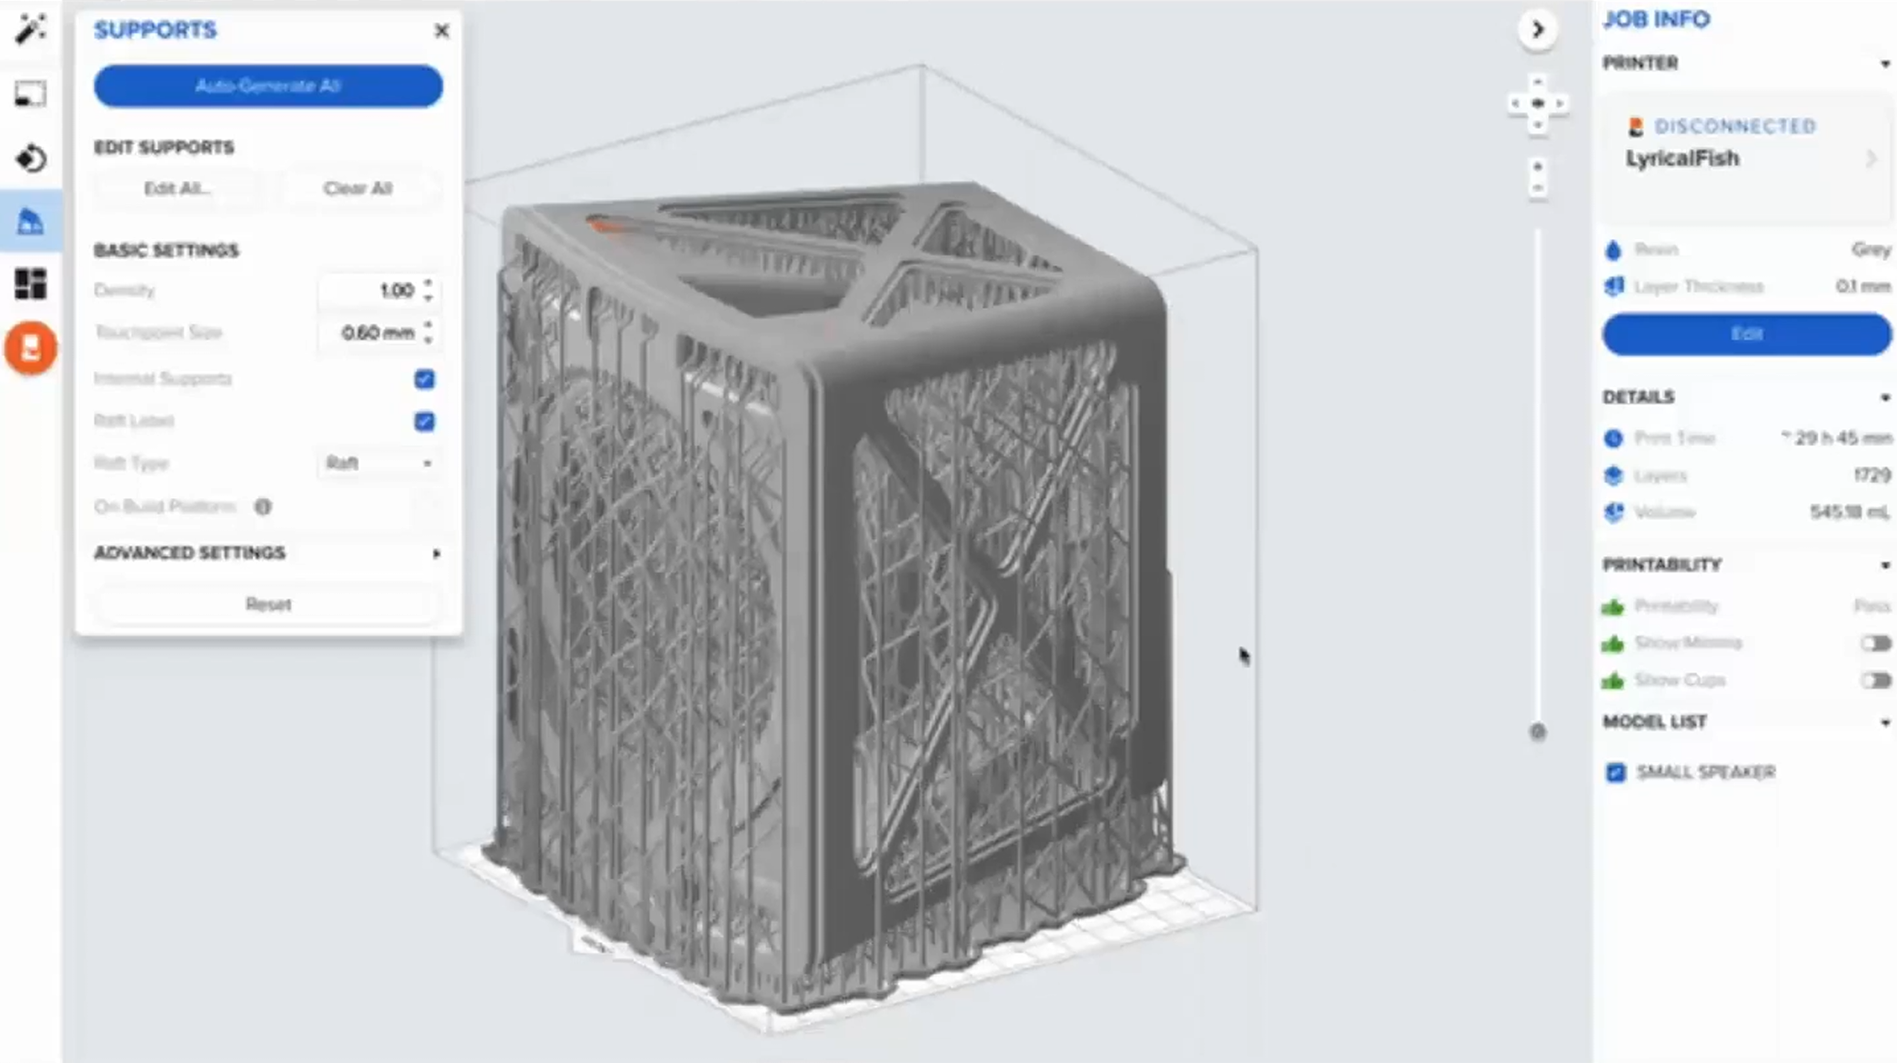
SLA / Vat Pho slicing with support structure

Slide 27
Considerations when picking print technology
Print Process Mechanism
How it Works
Advantages
Design considerations
FDM / FFF
Fused Deposition Modeling / Fused Filament Fabrication

Slide 28
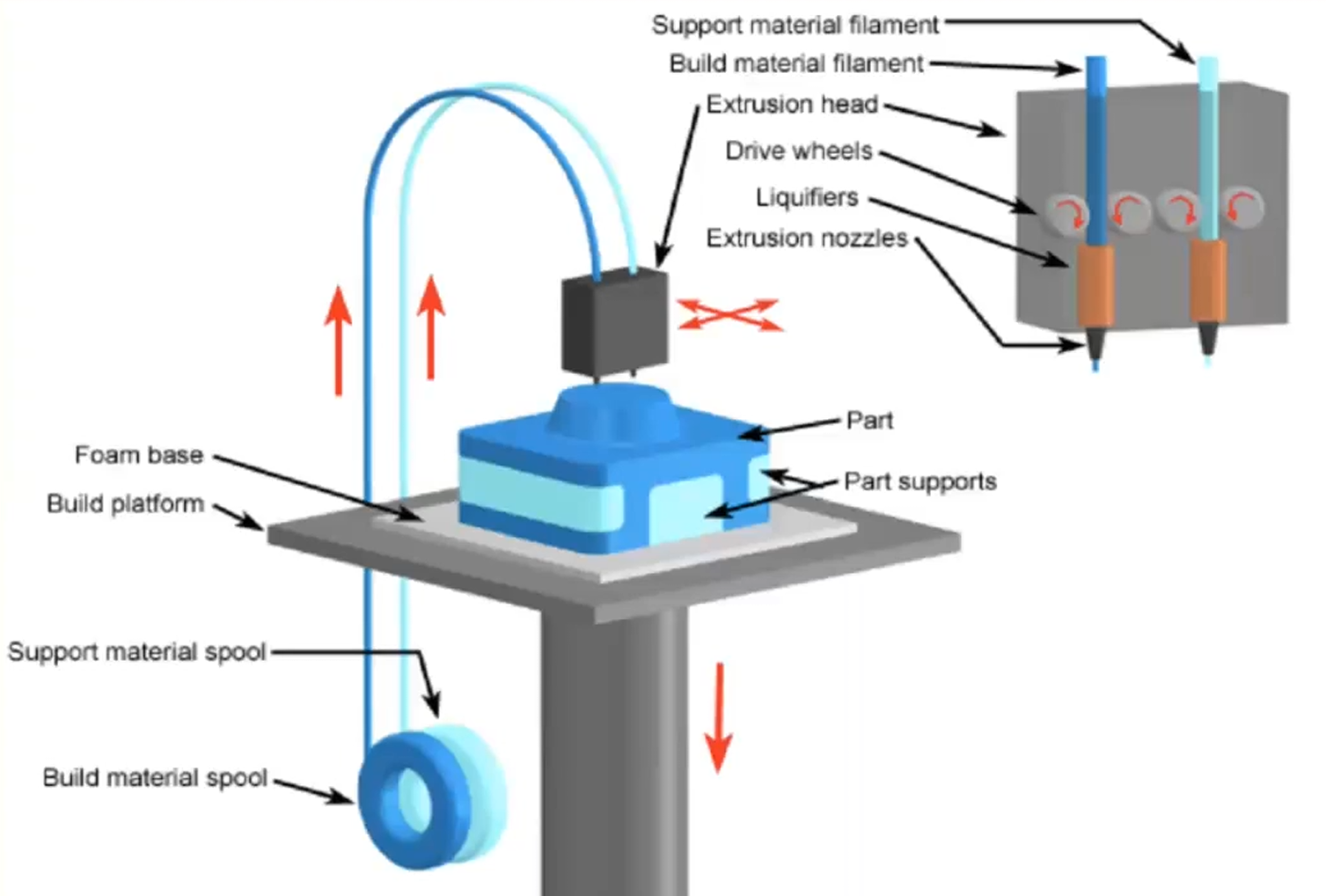
Fused Deposition Modeling / Fused Filament Fabrication FDM / FFF

Slide 29
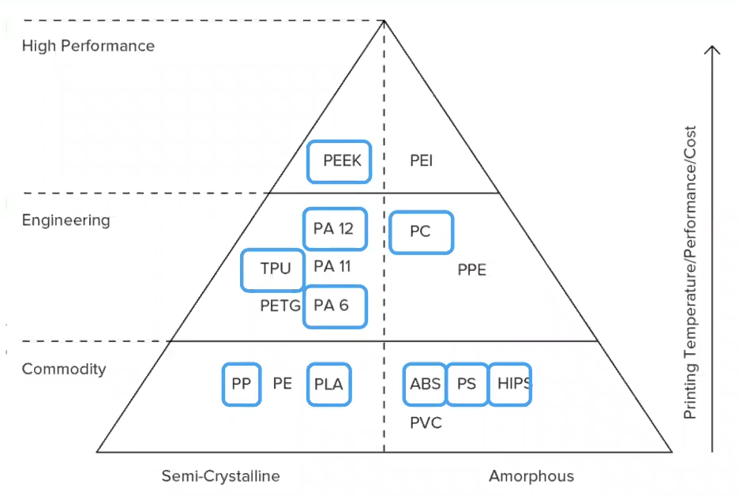

Wide range of thermoplastics for FDM PLA, PETG, ABS, PC, PEEK, etc.
FDM typically capable of produces strong part – Engineering grade thermoplastics

Slide 30




FDM Print Often Requires Support Structures

Slide 31

FDM is not solid like other processes “Infill & Shell Thickness”
FDM parts are usually not printed solid to reduce the print time and save material.
Instead, the outer perimeter is traced using several passes, called the shell, and
the interior is filled with an internal, low-density structure, called the infill.

Slide 32


Design considerations for FDM: More significant layer lines compared to SLS, SLA, DLP
It may be difficult to produce parts with fine features, textures or very thin walls

Slide 33


FDM Parts are generally not watertight or airtight
This issue can be mitigated with post processing but will add time and labor to part

Slide 34

SLS: Selective Laser Sintering
SLS has becoming more popular and does not require support structures

Slide 35

SLS: All part geometry's are functionally self-supporting
Unfused power supports parts during printing. Parts can also be nested on top of each other

Slide 36

3D Nesting in SLS powder bed fusion “cake”
The unused Nylon power can be recycled for future prints

Slide 37

SLS: Nylon is ideal for a range of functional applications, from engineering consumer products to healthcare.
SLS 3D Printing Materials
The most common material for selective laser sintering is nylon, a popular engineering thermoplastic beloved for its lightweight, strong, and flexible properties. Nylon is stable against impact, chemicals, heat, UV light, water, and dirt, making it ideal for both rapid prototyping and production.

Slide 38

Design considerations of SLS, heat up and cool down time.
Warping may occur if insufficient cool down time
Dusty post processing
Fewer material options than FDM
Very durable parts

Slide 39

SLA & DLP
Photopolymers
DLP is much faster, uses LED projection
SLA finer resolution uses laser
Watertight
Post cure time

Slide 40

SLA
Very fine resolution 25 micron layers
Liquid Thermoset polymers
watertight parts
Supports are needed to keep build on plate
All layers must have some connections, no island or feathery features without support

Slide 41


SLA – super fine resolution
Can produce highly detailed & translucent parts

Slide 42

SLA parts are highly isotropic, watertight parts

Slide 43

SLA Design considerations; print speed

Slide 44

Print Speed comparison

Slide 45

Post Processing considerations

Slide 46



Support removal – FDM – dissolvable or break away

Slide 47



Support removal – SLA – break away

Slide 48

Support removal – SLS powder

Slide 49
Current Internships, Industry & career connections
Internships & Partners
Sandia National Laboratories
Lam Research
NextFlex
SME Silicon Valley Chapter 98
Society of Manufacturing Engineers
Local Industry tours and networking
Resume & Career guidance
LinkedIn groups
CAD
CNC/CAM/MFG
3D Printing/AM
DMT Partners
HAAS
Siemens
Autodesk
SME
www.deanza.edu/dmt/

Slide 50

Great skills and technical training for a strong future!
3D Printing; Mass is expensive and complexity is free

Slide 51


This and more at De Anza College in the DMT Dep’t
www.DeAnza.edu/DMT
Build your skills and career opportunities with us now and for the future

Slide 52
www.deanza.edu/dmt/

